Slide 1

Predict Clicked Ads Customer Classification by using Machine Learning
Created by:
Muhammad Cikal Merdeka
Email : mcikalmerdeka@gmail.com
LinkedIn : linkedin.com/in/mcikalmerdeka
Github : github.com/mcikalmerdeka
Dedicated entry-level data scientist with analytical and experimental background of Physics. My graduation 2023, a pivotal year marked by significant advancements in artificial intelligence with the introduction of GPT-4 and other generative AI models, has fueled my curiosity and excitement to delve into the field of data. I have comprehensive grasp of data science methodology from business understanding to modelling process with proficiency in Python, SQL, Tableau, Power BI, Looker Studio and other tools related to data analytics workflow from several coursework and bootcamps.

Slide 2
Data Cleaning & Preprocessing
Drop Unnecessary Columns and Rename Columns
Unnamed: 0 columns in the dataset is initially dropped because it’s just ID column and it doesn’t store related information to our model, keeping them will just increase the dimension later.
Some columns are renamed to match the format for the entire dataframe and also add more information/context to them. Columns that renamed were : (original → new name)
Male → Gender
Timestamp → Visit Time
city → City
province → Province
category →Category
For more details, you can view the Jupyter notebook here.

Slide 3
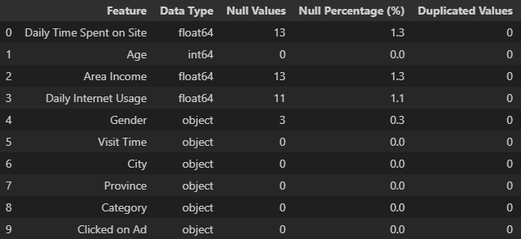
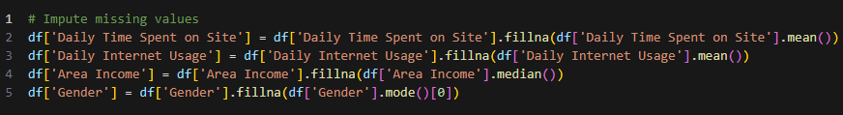
Data Cleaning & Preprocessing
Identifying Missing and Duplicated Values
Columns that missing values are Daily Time Spent on Site, Area Income, Daily Internet Usage, and Gender.
We will handle them by imputation with mean, median, and mode values considering the distribution of the values based on task 1.
No duplicated values in this dataset.

Slide 4
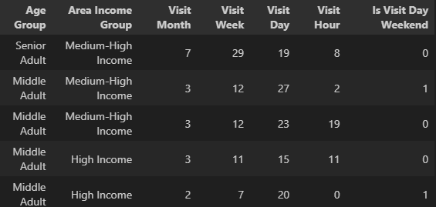
Data Cleaning & Preprocessing
Feature Engineering and Extraction
Visit Time feature data type is corrected to datetime and some features that are extracted from the original Visit Time are Visit Month, Visit Week, Visit Day, Visit Hour, and Is Visit Day Weekend. The year component is not extracted because we knew form the EDA that the data is only 6 month period ranging from January to July.
Some feature are also engineered from original features based on the grouping of the values range, they are Age Group and Area Income Group .
Engineered and Extracted Features

Slide 5
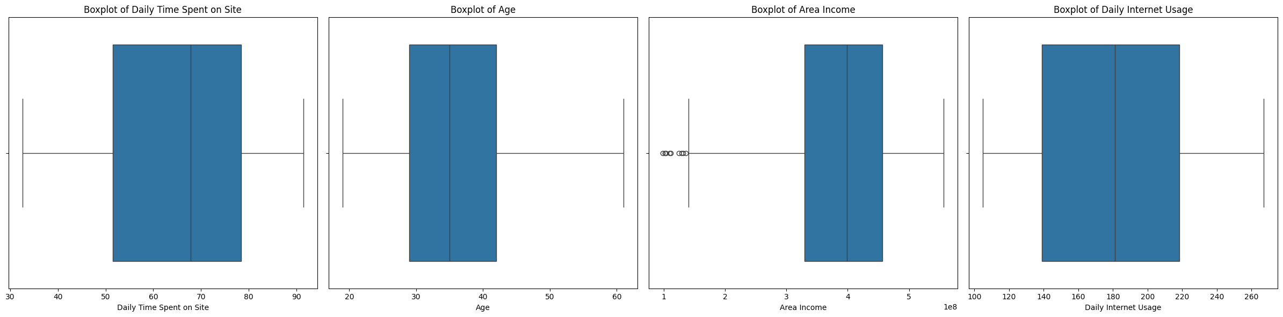
Data Cleaning & Preprocessing
Outliers Handling
Handling outliers with z-score method is done only to Area Income column since it have 9 extreme positive outliers as we found on EDA (task 1) beforehand.
Rows before removing outliers: 1000
Rows after removing outliers: 991

Slide 6
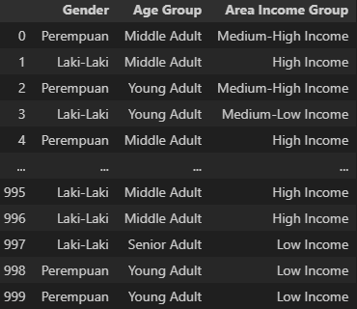
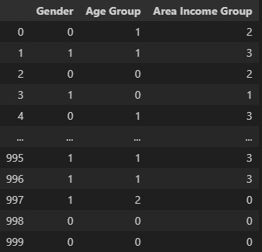
Data Cleaning & Preprocessing
Feature Encoding
There are 6 categorical column that will be encoded based on their data type.
Gender : Nominal type → One-hot encoding
City : Nominal type → One-hot encoding
Province : Nominal type → One-hot encoding
Age Group : Ordinal type → Label encoding
Area Income Group : Ordinal type → Label encoding
Before Encoding
After Encoding
* As for the one-hot encoded features are not shown because way to many unique values led to increasing in dimensions.
Those features will later be dropped in the feature selection process.

Slide 7
Data Cleaning & Preprocessing
Feature Selection
At this point we now have 70 columns which is way too many. That’s why feature selection procedure need to be done. The process is through checking Spearmann correlation heatmap and analyzing feature importance (statistical test) of mutual information and chi square test with SelectKBest scikit-learn method.
Reviewing the statistical test values of several features generated, I've decided not to use some engineered features in training the model due to multicollinearity issues with the original features. Therefore, these engineered features will only be used for analysis purposes.
Meanwhile, some one-hot encoded features like city and province have many features with very low importance to the target, so those features will not be used.
Most of the features that will be used are from original features. (Check the details of the analysis on the source code, note that features stated here are not fixed yet because experiment with the model by analyzing the evaluation metrics need to be conducted later)
Features that are used : Daily Time Spent on Site, Age, Area Income, Daily Internet Usage, Gender, Clicked on Ad

Slide 8
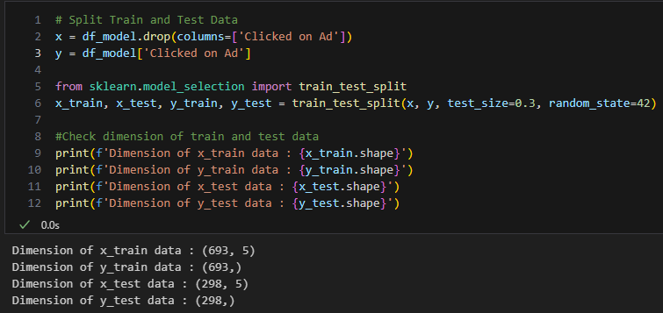
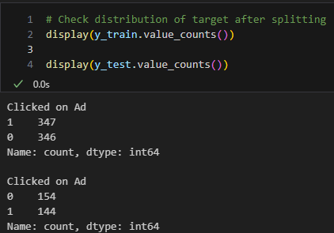
Data Cleaning & Preprocessing
Splitting Train and Test Data
Train-test split is conducted with proportion of 70-30, which makes 693 rows go into training data while the remaining 298 rows go into test data.

Slide 9
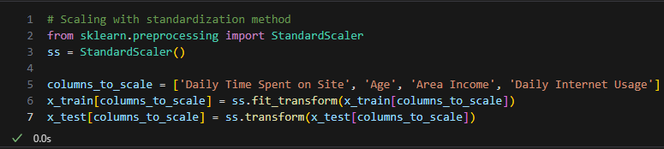
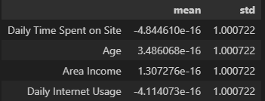
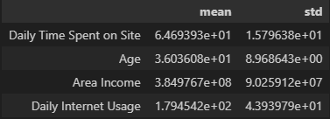
Data Cleaning & Preprocessing
Feature Scaling
After we have all the values in numerical form and conducted train-test split, we need to transform (scale) the values to ensure fair calculations, especially for features that have extreme range of values like Area Income.
We use standardization for scaling method to ensure that all columns have mean of 0 and standard deviation of 1.
Before Scaling
After Scaling

